Slide 1

Simplification of educational content using text summarization and text to speech
Batch 11
Avani Shrivastava (RA1811026020015)
N D Bhavana (RA1811026020023)
Niharika G Menon (RA1811026020040)
Guide: Ms.S.Priya M.E (Ph.D), AP/CSE, SRMIST, Ramapuram

Slide 2
Abstract
Online education suffers from the problem of having too much information to sift through.
To increase the efficiency of gaining knowledge from large documents, text summarisation and audio data has been much more efficient
Therefore propose system by comparing several techniques for summarization and text to speech and selecting the techniques most compatible with each other to combine into a new system that will summarise long text documents into an audio summary.

Slide 3
Objectives
To compare and identify the best strategy to implement text summarisation of documents given time and resources available
To compare and identify the best strategy to implement text to speech of the summary obtained given time and resources available
Effective combination of both techniques and build an effective easy to use interface to improve the user experience

Slide 4
Scope
Scope of the project is:
Developing a summarization in combination with a text to speech system
Using this system for the purpose of summarizing educational documents

Slide 5
Introduction
There is an abundance of text in educational resources online
Therefore smarter learning methods are necessary:
Text summarisation- current emphasis of the discipline of NLP, improve the efficiency of collecting knowledge from massive documents.
Auditory data - more effective means of delivering information, particularly for those who cannot read or have difficulty understanding text.
So we propose a system that would summarise long text documents into an audio summary by evaluating different strategies for summarizing and text to speech and picking the techniques that are most compatible with each other to integrate into a new system.

Slide 6
Introduction
Text summarization: use of machines to summarise a document or set of documents using heuristics or statistical methods.
Summary: condensed piece of writing that accurately captures and expresses the most significant and relevant information from the document or documents we're summarising.
Main emphasis of the system is on the hybrid text summarization module
Google Text-to-Speech API to get the audio version of the summary.

Slide 7
Existing systems- based on literature survey
SL No. | TITLE | AUTHORS | JOURNAL | TECHNIQUES | DRAWBACKS /LIMITATIONS
1. | A Two-Stage Transformer-Based Approach for Variable-Length Abstractive Summarization | Ming-Hsiang Su, Chung-Hsien Wu, Hao-Tse Cheng | IEEE/ACM Transactions on Audio, Speech, and Language Processing | The model consists of a text segmentation module and a two-stage Transformer-based summarization module. Text segmentation model: divides input into a specified no.of segments, each segment uses the abstractive summarization to form a variable-length abstractive summary transformer and the language representation model BERT. | Summary generated has very less information due to insufficient variable-length summary. Most of the input text in LCSTS are short articles, which limit the ability of the variable-length abstractive summarization system. Short article cannot be cut into too many segments
2. | Extractive Document Summarization Based on Dynamic Feature Space Mapping | Samira Ghodratnama, Amin Beheshti , Mehrdad Zakershahrak, Fariborz Spbhanmanesh. | IEEE Access | A clustering algorithm is used to understand the underlying structure of data and an iterative Process is done to minimize the classification error in each cluster. Since the algorithm performs in an iterative process:gradient descent, simple clustering (k-means) and classification (KNN) are used to support efficiency. | Future potential-to use the knowledge of the crowd to update weights in addition to the weights learned by the system,so considering the preference of users in summarizing implicitly. In the redundancy aspect: ExDoS competes with BANDITSUM.

Slide 8
SL No. | TITLE | AUTHORS | JOURNAL | TECHNIQUES | DRAWBACKS /LIMITATIONS
3. | Extractive Text Summarization Using Sentence Ranking | J.N.Madhuri, Ganesh Kumar.R | 2019 International Conference on Data Science and Communication (IconDSC) | 1. Reading the given text tokenizing it. 2. Removal of stop-words and Parts-of-speech are assigned to each token. 3. Weight assignment to individual tokens by using:Wt = (1) 4.Calculating Weight frequency of tokens :Wtf = (2) 5. Individual terms ranks are calculated. 6. extract the high weighted frequency sentences to get the summarized text. (More accurate than the traditional approach) | Still only extractive summarisation, system does not entirely understand the meaning of the sentence and cannot reinterpret it like abstractive
4. | A Combined Extractive With Abstractive Model for Summarization | Wenfeng Liu , Yaling Gao, Jinming Li, and Yuzhen Yang | IEEE Access | Hybrid abstractive and extractive summarization : 1. Extractive model selects the most significant sentences in the document. Taking into account the differences or features of sentences. Embeddings of extracting sentences are constructed. 2. Abstractive model that rewrites these sentences as the nal summarization.We use the beam search. Sentence with highest score is the pseudo-summary. 3. Next cycle is executed. The best pseudo-summary is the last summarization. | Does not involve multi-document summaries

Slide 9
SL No. | TITLE | AUTHORS | JOURNAL | TECHNIQUES | DRAWBACKS /LIMITATIONS
5. | Statistical Parametric Speech Synthesis Incorporating Generative Adversarial Networks | Yuki Saito , Shinnosuke Takamichi and Hiroshi Saruwatari. | IEEE/ACM Transactions on Audio, Speech, and Language Processing | Statistical parametric speech synthesis incorporating generative adversarial networks (GANs) is proposed. Proposed algorithm incorporating the Wasserstein GAN improved synthetic. speech quality the most in comparison with various GANs. GANs minimize the divergence (i.e., distribution difference) between the natural and generated speech parameters, the proposed method effectively alleviates the oversmoothing effect on the generated speech | Further investigate the behavior in relation to the hyper-parameter settings, adopt feature functions which are more effective to detect synthetic speech than the identity function, and devise discriminator models with linguistic dependencies.

Slide 10
SL No. | TITLE | AUTHORS | JOURNAL | TECHNIQUES | DRAWBACKS /LIMITATIONS
6. | An Improved Text to Speech Technique for Tamil Language Using Hidden Markov Model | Jayakumari.J.Femina Jalin.A.. Department of Electronics and Communication Engineering, Mar Baselios College of Engineering and Technology, Kerala. | 2019 7th International Conference on Smart Computing & Communications (ICSCC) | Multi feature, with a Hidden Markov Model (HMM) predictor is used to convert text to speech. 1.The initial phase: is to change over given Tamil content to relating Unicode. 2.Different combinations of randomly selected word’s waveforms are collected and their corresponding speed and frequency are estimated. 3.And finally the measure of speech quality is done by Mahala Nobis distance (MND) and Mean Square Error (MSE). | MSE is a risk function, relating to the normal estimation of the squared mistake misfortune, so the results shown may not be true
7. | End-to-end Conversion Speed Analysis of an FPT.AI-based Text-to-Speech Application | Tran Duc Chung, Micheal Drieberg, Mohd Fadzil Bin Hassan, Alexandra Khalyasmaa, | 2020 IEEE 2nd Global Conference on Life Sciences and Technologies (LifeTech 2020) | FPT.AI API:The TTS API takes four arguments for forming an HyperText Transfer Protocol (HTTP) request r: POST Data which contain text to be converted to speech,) voice, speed and prosody to form HTTP header. The latter three arguments are not required by the TTS server during a request. The reason is that by default, normal speed (speed = 0) and female voice are used | As the text length increases, the time taken to perform TTS task increases as well, so its not scalable

Slide 11
SL No. | TITLE | AUTHORS | JOURNAL | TECHNIQUES | DRAWBACKS /LIMITATIONS
8. | From Text To Speech Summarization | Kathleen McKeown, Julia Hirschberg, Michel Galley and Sameer Maskey . Columbia University New York NY 10027 | Proceedings. (ICASSP '15). IEEE International Conference on Acoustics, Speech, and Signal Processing, 2015 | Text to speech training methods:1. segmentation of spoken documents at many levels, depending upon genre-utterance, turn, topic or story. 2.extraction of acoustic and prosodic information (pitch, intensity, timing) Summarization:two-level approach :1.summarizing errorful spoken material by identifying domain-specific aspects. 2.Filtering lexical/linguistic features for summary extraction | Use of lexical extraction methods to hypothesize important topics in a text However, such methods are still limited. No specific technique or algorithm stated,was just a general approach, missing quantitative report for the result.
9. | Text Summarization Using Natural Language Processing And Google Text To Speech API. | Subash Volet, Chaitan Raju, Teja Rani, Mugada Swetha. | International Research Journal of Engineering and Technology (IRJET) e,Volume: 07 Issue: 05 ,May 2020 | Text Rank algorithm(Access time for searching is reduced):keyword Extraction & Sentence Extraction. Additionally converting the summarized Text into Audio File using GTTS API | This paper mainly focused on creating a system that gets concise summaries of articles only and no new approach for text to speech process is given, only the existing API is used.

Slide 12
SL No. | TITLE | AUTHORS | JOURNAL | TECHNIQUES | DRAWBACKS /LIMITATIONS
10. | Multimode Summarized Text to Speech Conversion Application | Archit Sehgal , Gitika Khanna . Department of Computer Science, HMR Institute of Technology & Management Hamidpur, Delhi-110036, India | IITM Journal of Management and IT,Volume 10, Issue 1 ∙January-June 2019 | TextRank Algorithm with modification to the graph applied on editable text/ image/audio/ video(input can be taken in many forms) and then the ranked parameters are passed to the ROUGE evaluation module(ROUGE-L used the longest common subsequence (LCS) approach i.e. the longer the LCS, more will be the similarity Text-to-speech : text normalization and assigning phonetic transcription to each word. Analysis of various speech synthesis techniques such as Concatenative synthesis, Articulatory synthesis, Formant synthesis, Domain Specific synthesis, Unit selection synthesis, Diphone synthesis, HMM based Synthesis etc | However there is a scope for video analysis. Since the paper discusses about taking input from multiple modes. Also, improvements can be made to make the summary algorithm more efficient and accurate. This will in turn ensure that the generated summary has its logical meaning.

Slide 13
SL No. | TITLE | AUTHORS | JOURNAL | TECHNIQUES | DRAWBACKS /LIMITATIONS
11. | Extractive Broadcast News Summarization Leveraging Recurrent Neural Network Language Modeling Techniques | Kuan-Yu Chen, Shih-Hung Liu, Berlin Chen, Hsin-Min Wang, Ea-Ee Jan, Wen-Lian Hsu and Hsin-Hsi Chen | IEEE/ACM TRANSACTIONS ON AUDIO, SPEECH, AND LANGUAGE PROCESSING, VOL. 23, NO. 8, AUGUST 2015 | 1.Novel use of recurrent neural network language modeling (RNNLM) framework for extractive broadcast news summarization. 2. A hierarchical training strategy to obtain the corresponding RNNLM model for each sentence of a spoken document to be summarized | Disadvantages of an extractive summarisation system and is not integrated with a text-to-speech system.
12. | A Divide-and-Conquer Approach to the Summarization of Long Documents | Alexios Gidiotis and Grigorios Tsoumakas | IEEE | A novel divide-and-conquer method for the neural summarization of long documents: first breaks both the document and its target summary into multiple smaller source-target pairs, then trains a neural model that learns to summarize these smaller document parts, and finally during inference aggregates the partial summaries in order to produce a final complete summary. Paired with transformer model PEGASUS | Not been tried in combination with recent state-of-the art models with comparative performance, and has not been used with a text-to-speech system till date.

Slide 14
SL No. | TITLE | AUTHORS | JOURNAL | TECHNIQUES | DRAWBACKS /LIMITATIONS
13. | Automatic Text Summarization Using Gensim Word2Vec and K-Means Clustering Algorithm | Mofiz Mojib Haider,Md. Arman Hossin ,Hasibur Rashid Mahi,Hossain Arif | 2020 IEEE Region 10 Symposium (TENSYMP) | 1. Gensim Word to vector 2. K-Means Clustering. | Model showed a higher accuracy on business articles since the sentence scoring algorithm gives priority to numerical values and the business article contains more numerical values .
14. | Abstractive Text Summarization Approaches with Analysis of Evaluation Techniques | Abdullah Faiz Ur Rahman Khilji Utkarsh Sinha Pintu Singh Adnan Ali Partha Pakray | International Conference on Computational Intelligence in Communications and Business Analytics-2021 | 1. Two approaches are used for text summarization: Extractive approach Abstractive approach 2. Two models- GAN and seqtoseq (trained the model using long short-term memory (LSTM) encoder-decoder) | No hybrid approach

Slide 15
SL No. | TITLE | AUTHORS | JOURNAL | TECHNIQUES | DRAWBACKS /LIMITATIONS
15. | Survey on Extractive Text Summarization Methods with Multi-Document Datasets | P N Varalakshmi K,Jagadish S Kallimani | 2018 International Conference on Advances in Computing, Communications and Informatics (ICACCI) | Extractive summarization methods: Regression model for relative importance of words + summary generation through greedy algorithm. Essence vector framework to pick out most meaningful information while excluding unnecessary information. Genetic Algorithm Model Swarm Intelligence Model Coherence focused Model. | Drawbacks associated with extractive methods

Slide 16
Existing work
The best text summarization system is a hybrid system: combining both extractive and abstractive. There are several text to speech systems available, with comparative performance. Both can be combined to create a novel system.

Slide 17
Proposed work
While there are several applications which can read data from long documents and convert them into audio form, there are none which can both perform long form text summarization and convert the text into speech. Thus we propose a system that will be able to read long documents, summarise them effectively and then convert the text into speech. The text summarization method that is proven to work best is a combination of extractive and abstractive summarization. This method shall be used with text to speech to create a novel system that serves people unable to read (such as people with visual impairment) or even neurodivergent people who find it difficult to read large chunks of data at a time.

Slide 18
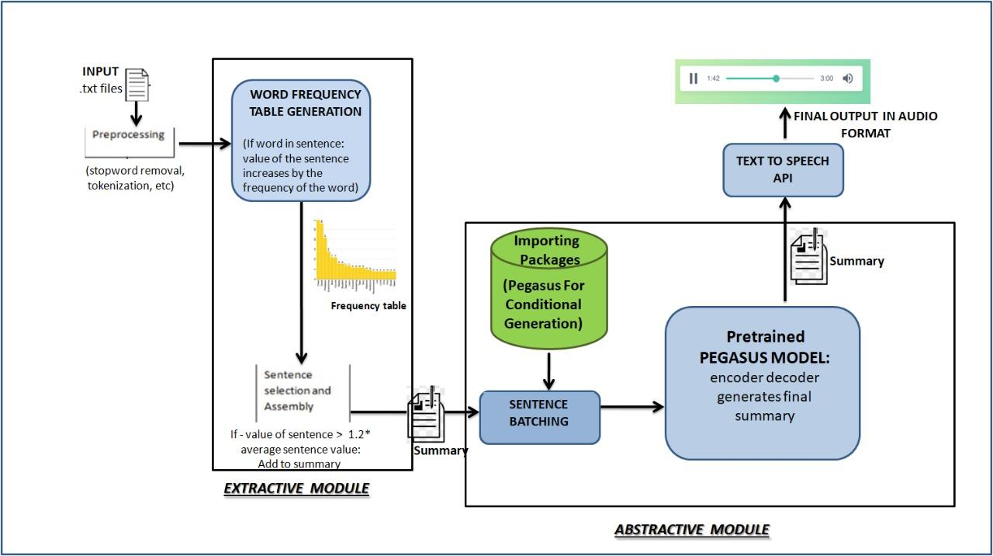
Architecture diagram

Slide 19
Module Description
Summarization module: Extractive summarization using ranking by word frequency and Abstractive summarisation using PEGASUS
Text to speech module: Google text to speech API

Slide 20
Algorithm used in each module
Summarization algorithms:
Extractive:
1: Preprocessing of text (stopword removal, tokenization, etc)
2: Building a word frequency table
3: For each sentence:
If word is in sentence, the value of the sentence increases by the frequency of the word in the frequency table
4: For each sentence:
If the value of the sentence is greater than 1.2* average sentence value, it is added to the summary

Slide 21
Algorithm used in each module
2. Abstractive summarisation:
1: Import pre-trained PEGASUS model
2: Use summary from extractive summarisation and prepare the batch
3: Pass the batch through the encoder-decoder to get the final summary

Slide 22
Implementation
Extractive:
Conceptually, imagine running the
time-scaling algorithm on all possible paths between the start and goal states. The first
step is to define a grid on the workspace and construct all collision-free paths (without
sharp turns) between the start and goal states moving along edges or diagonals of the
grid. The next step is to quickly compute rough lower-bound estimates of the traveling
times of these paths using a maximum velocity limit during the motion. The best of these paths is then submitted to the full time-scaling algorithm,
generating an upper bound on the optimal travel time. Of the remaining paths, the lower bounds
are more carefully calculated, and the process continues, using increasingly accurate
estimates of the lower bounds as the number of candidate paths is reduced.

Slide 23
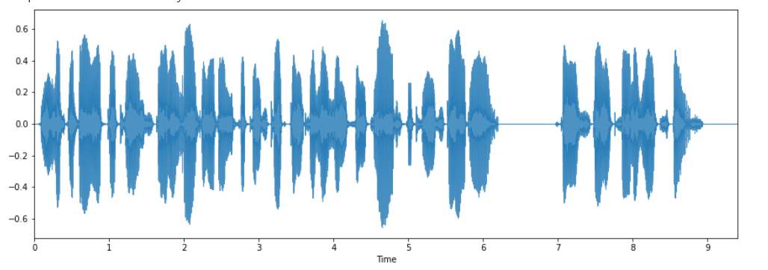
Implementation
Extractive + Abstractive summary:
['We have developed a time-scaling algorithm for constructing collision-free paths between start and goal states on a workspace.']
Audio clip:

Slide 24
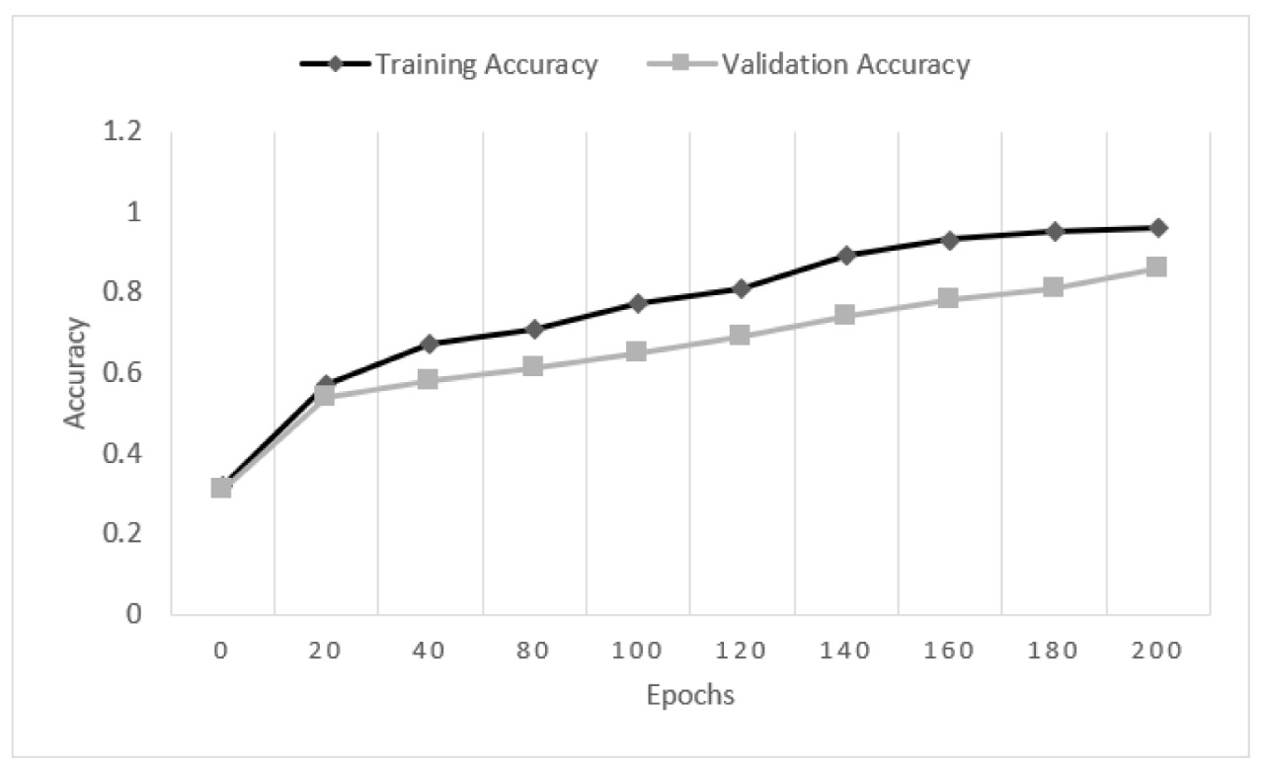
Results
Abstractive method
Accuracy for each epoch

Slide 25
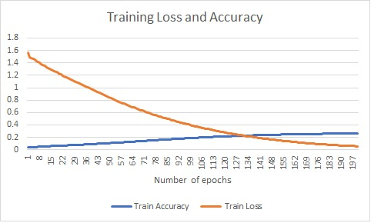
Results
Extractive method
Accuracy for each epoch

Slide 26
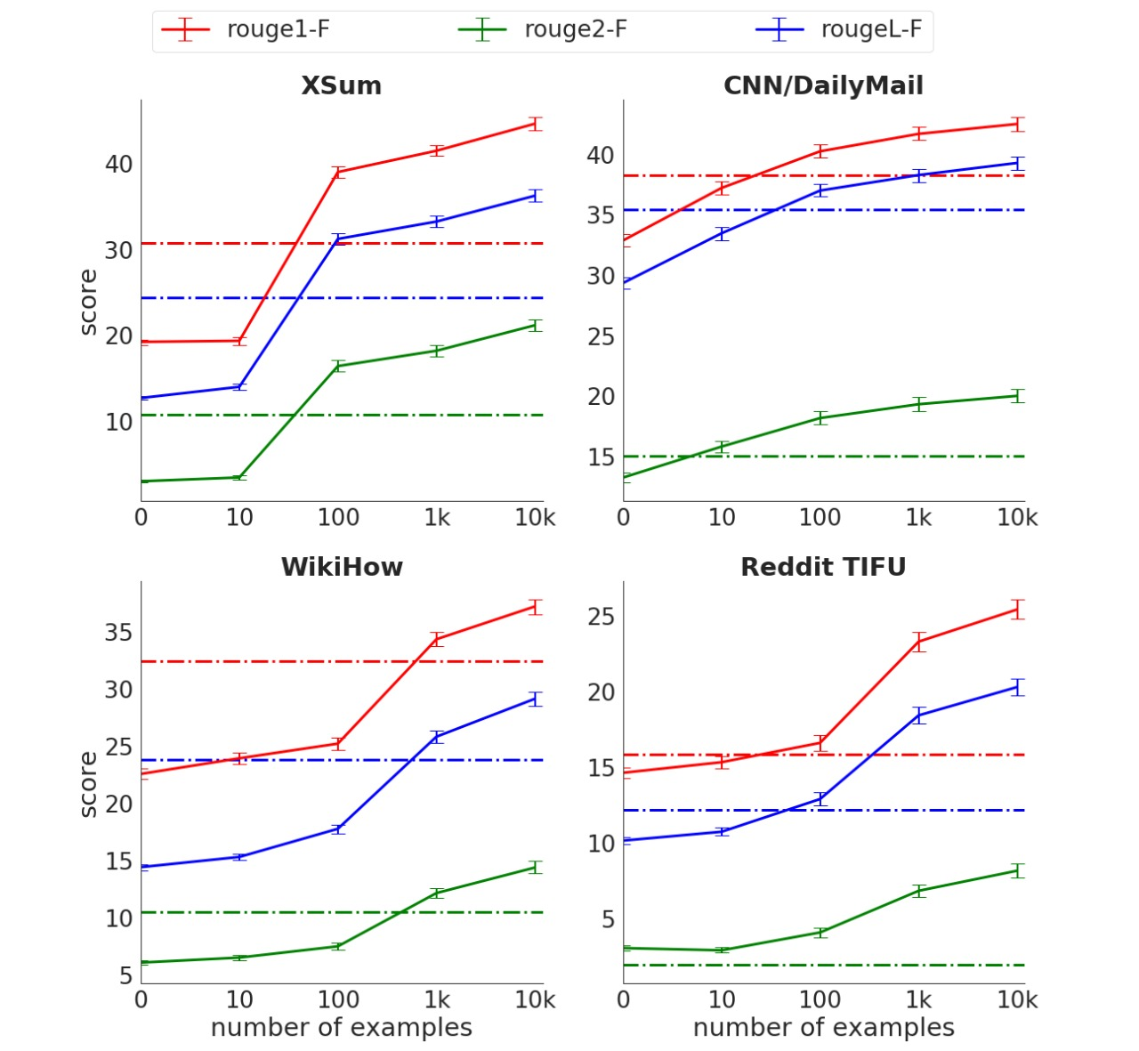
Results
Pegasus module,
4 websites pages are summarized using 4 diff rouge algos, and accuracy score are depicted

Slide 27
ROGUE scores for our model
Extractive | Abstractive | Hybrid
0.71 | 0.60 | 0.88

Slide 28
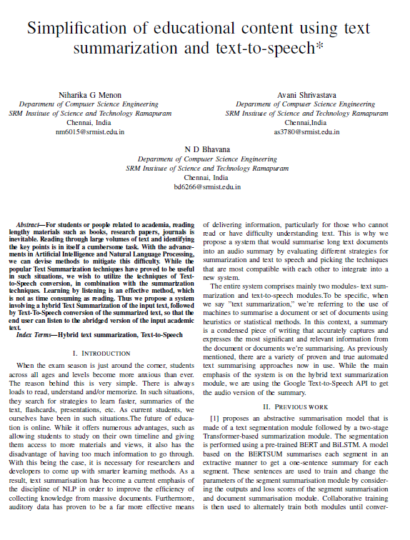
Paper of the proposed work

Slide 29
Conclusion and future directions
The proposed work presents a system, which given an educational text can produce an audio summary. This is done by a mix of extractive and abstractive summarisation to generate a summary that captures the advantages of both the system. The text summary is coherent and readable. This, when converted to an audio summary, is intelligible.
Some future directions for this work are:
Trying other techniques for extractive and abstractive modules, such as supervised methods and other unsupervised methods to compare performance and accuracy of summarisation.
The text to speech module can be improved upon, for example, taking sentiment and modulation of voice into account to make it closer to human speech.
There is additional work to be done in summarising text with formulae and scientific notation, because the summariser at present performs slightly poorer in these cases.

Slide 30
Reference section
[1] Su, M.H., Wu, C.H. and Cheng, H.T., 2020. A Two-Stage Transformer-Based Approach for Variable-Length Abstractive Summarization. IEEE/ACM Transactions on Audio, Speech, and Language Processing, 28, pp.2061-2072.
[2] Ghodratnama, S., Beheshti, A., Zakershahrak, M. and Sobhanmanesh, F., 2020. Extractive document summarization based on dynamic feature space mapping. IEEE Access, 8, pp.139084-139095.
[3] Gidiotis, A. and Tsoumakas, G., 2020. A divide-and-conquer approach to the summarization of long documents. IEEE/ACM Transactions on Audio, Speech, and Language Processing, 28, pp.3029-3040.
[4] Liu, W., Gao, Y., Li, J. and Yang, Y., 2021. A Combined Extractive With Abstractive Model for Summarization. IEEE Access, 9, pp.43970-43980.
[5] Madhuri, J.N. and Kumar, R.G., 2019, March. Extractive text summarization using sentence ranking. In 2019 International Conference on Data Science and Communication (IconDSC) (pp. 1-3). IEEE.
[6] Mofiz Mojib Haider,Md. Arman Hossin,Hasibur Rashid Mahi,Hossain Arif.Automatic Text Summarization Using Gensim Word2Vec and K-Means Clustering Algorithm,2020 IEEE Region 10 Symposium (TENSYMP), 5-7 June 2020, Dhaka, Bangladesh.

Slide 31
Reference section
[7] Khilji, A.F.U.R., Sinha, U., Singh, P., Ali, A. and Pakray, P., 2021, January. Abstractive Text Summarization Approaches with Analysis of Evaluation Techniques. In International Conference on Computational Intelligence in Communications and Business Analytics (pp. 243-258). Springer, Cham.
[8] Yuki Saito , Shinnosuke Takamichi and Hiroshi Saruwatari. Statistical Parametric Speech Synthesis Incorporating Generative Adversarial Networks by Yuki Saito, Shinnosuke Takamichi and Hiroshi Saruwatari, IEEE conference edition.
[9] Jayakumari.J.Femina Jalin.A.An Improved Text to Speech Technique for Tamil Language Using Hidden Markov Model, 7th International Conference on Smart Computing & Communications (ICSCC).
[10]Tran Duc Chung, Micheal Drieberg, Mohd Fadzil Bin Hassan, Alexandra Khalyasmaa,
End-to-end Conversion Speed Analysis of an FPT.AI-based Text-to-Speech Application,2020 IEEE 2nd Global Conference on Life Sciences and Technologies (LifeTech 2020).
[11 ] Kathleen McKeown, Julia Hirschberg, Michel Galley and Sameer Maskey .
Columbia University New York NY 10027.From Text To Speech Summarization,Proceedings(ICASSP '15),IEEE International Conference on Acoustics, Speech, and Signal Processing, 2015.
[12] Subash Volet, Chaitan Raju, Teja Rani, Mugada Swetha.Text Summarization Using Natural Language Processing And Google Text To Speech API,International Research Journal of Engineering and Technology (IRJET) e,Volume: 07 Issue: 05 ,May 2020.
[13] Archit Sehgal , Gitika Khanna .Multimode Summarized Text to Speech Conversion Application,IITM Journal of Management and IT,Volume 10, Issue 1,January-June 2019
[14]Chen, K.Y., Liu, S.H., Chen, B., Wang, H.M., Jan, E.E., Hsu, W.L. and Chen, H.H., 2015. Extractive broadcast news summarization leveraging recurrent neural network language modeling techniques. IEEE/ACM Transactions on Audio, Speech, and Language Processing, 23(8), pp.1322-1334.
[15] P N Varalakshmi K,Jagadish S Kallimani.Survey on Extractive Text Summarization Methods with Multi-Document Datasets. 2018 International Conference on Advances in Computing, Communications and Informatics (ICACCI)

